Slide 1

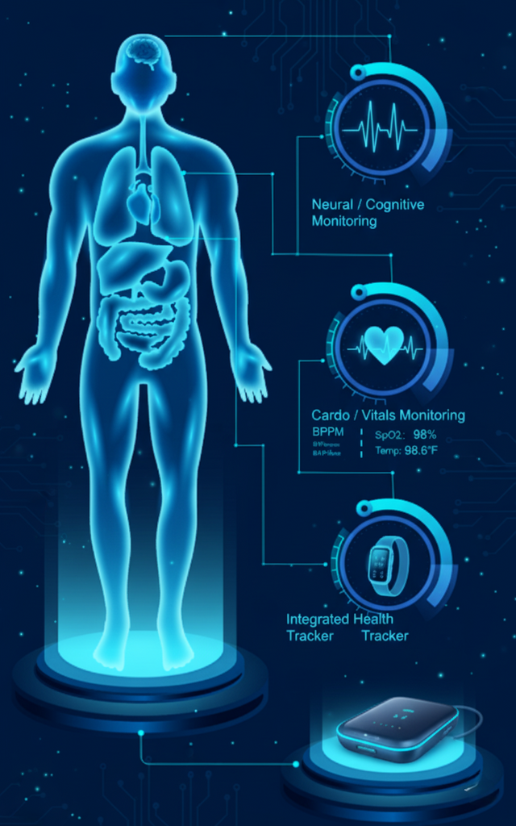
AI-Powered Smart Health
Monitoring and Early Disease Detection System
AURA-AI: Autonomous & Ubiquitous Remote-monitoring for
Advanced AI-powered Health
HeartWare | CIEL Kingston vibeAIthon 2025

Slide 2

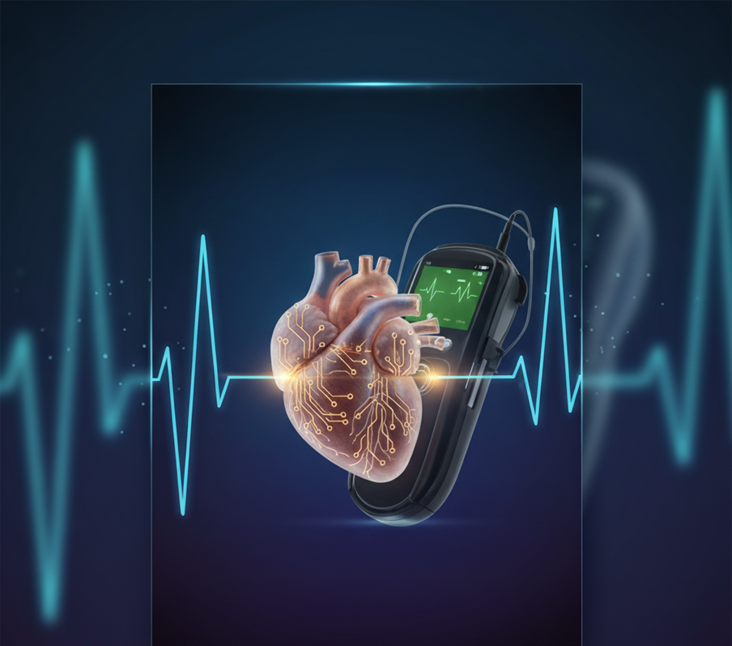

Problem Recap & Objective
Validated Problem
Rural and semi-urban communities lack access to continuous, affordable health monitoring.
Traditional clinical devices are costly, bulky, and unsuitable for home or emergency deployment.
Absence of early detection mechanisms often delays medical attention, increasing preventable mortality.

Slide 3
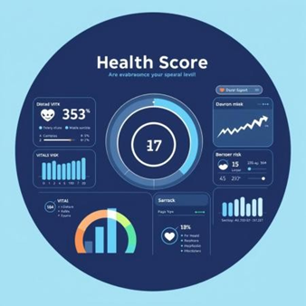
Problem Recap & Objective
Objective of Prototype
Build a portable, AI-powered multi-sensor health device that autonomously tracks ECG, SpO₂, BP (via PTT), respiration, temperature, and air quality.
Use edge AI (1D-CNN + LSTM) for real-time anomaly detection and disease-risk prediction without cloud dependency.
Deliver instant alerts and cloud visualization to enable rapid caregiver response.

Slide 4

Problem Recap & Objective
Expected Outcomes / Success Metrics
accurate ECG arrhythmia detection (validated with MIT-BIH dataset).
Stable, noise-free vital-sign data from calibrated sensors.
End-to-end system cost < ₹2,500 in production.
Reliable Telegram & ThingSpeak alerts during abnormal events

Slide 5
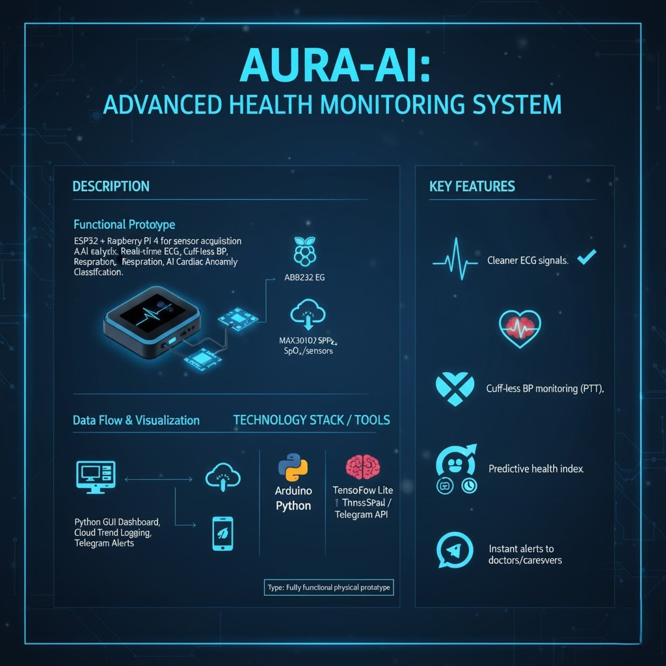
Prototype Overview
Expected Outcomes / Success Metrics
accurate ECG arrhythmia detection (validated with MIT-BIH dataset).
Stable, noise-free vital-sign data from calibrated sensors.
End-to-end system cost < ₹2,500 in production.
Reliable Telegram & ThingSpeak alerts during abnormal events

Slide 6
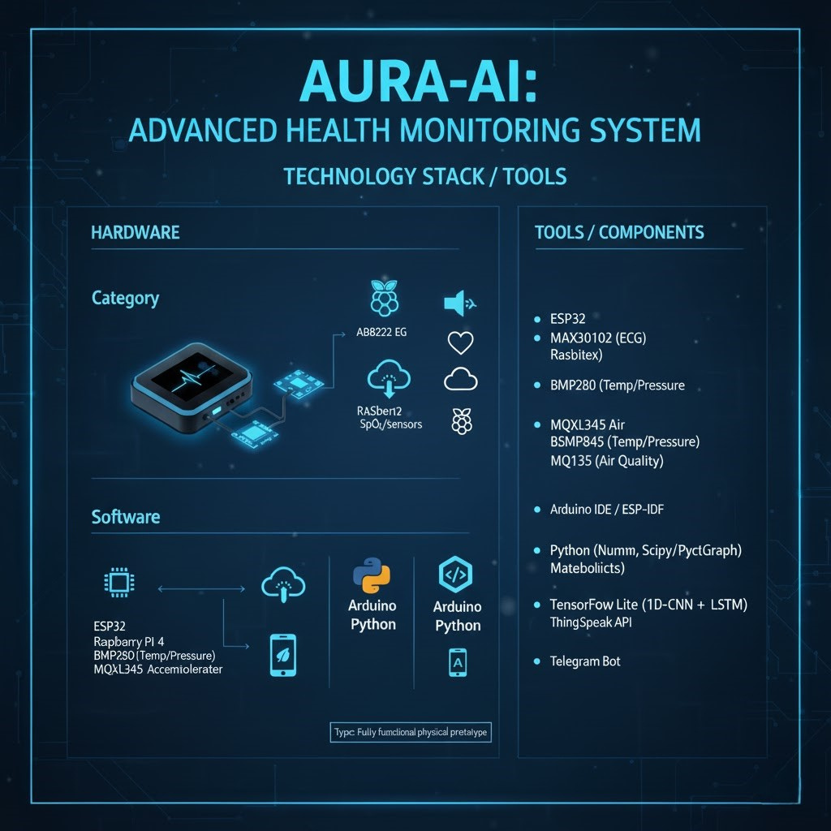

Slide 7
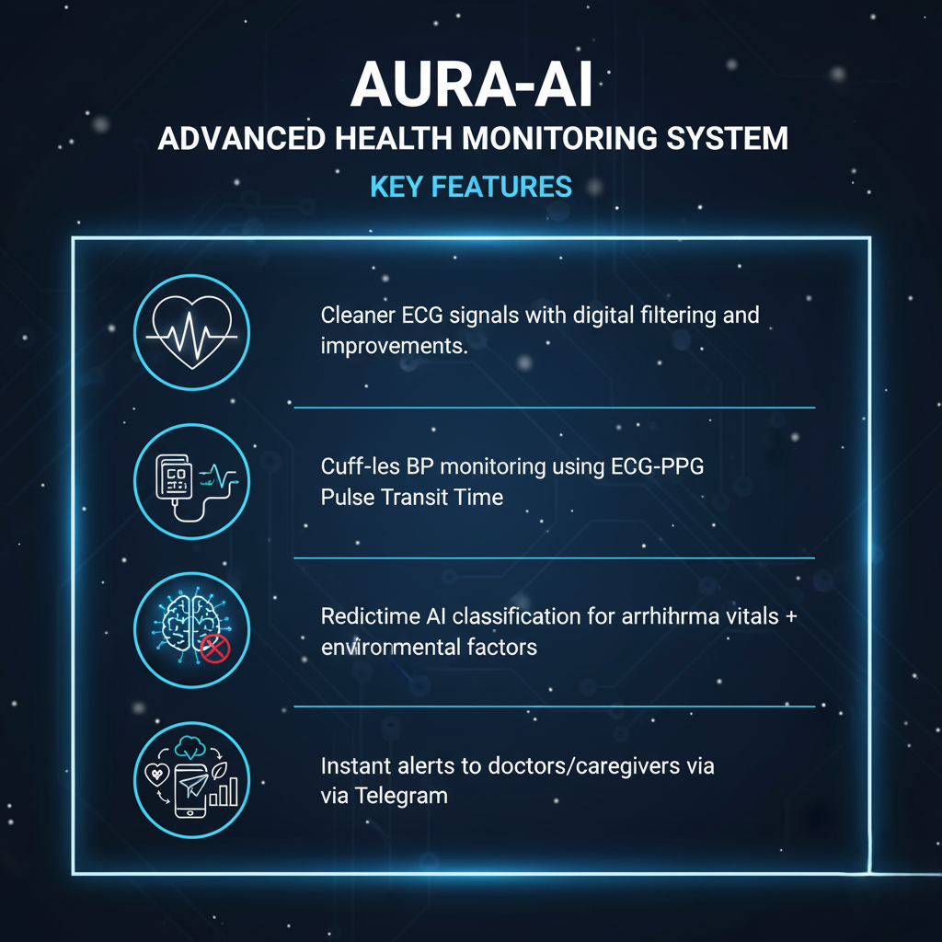
Key Features
Cleaner ECG signals with digital filtering and grounding improvements.
Cuff-less BP monitoring using ECG–PPG Pulse Transit Time.
Real-time AI classification for arrhythmia and abnormal vitals.
Predictive health index combining vitals + environmental factors.
Instant alerts to doctors/caregivers via Telegram.

Slide 8
👩‍⚕️ User Experience & Impact
User Journey:
AURA-AI auto-calibrates on startup, captures ECG, SpO₂, BP, and air-quality data in real time, analyzes it using on-device 1D-CNN/LSTM AI, and instantly alerts users via Telegram and ThingSpeak. The dashboard displays live vitals and health trends for continuous monitoring.
Innovation:
Edge-AI for real-time detection without internet, cuff-less BP via PTT, sensor fusion of biomedical + environmental data, and an open-source, low-cost design ready for mass deployment.
Impact:
Delivers AI-powered diagnostics to rural clinics and ambulances, enables 24/7 home care for elderly and chronic patients, and aligns with NDHM & UN SDG 3 for accessible, preventive healthcare.
Next Steps:
Enhance AI with larger datasets, add mobile app + wearable version, conduct clinical pilots, and pursue ISO/CE certification and healthcare partnerships.

Slide 9
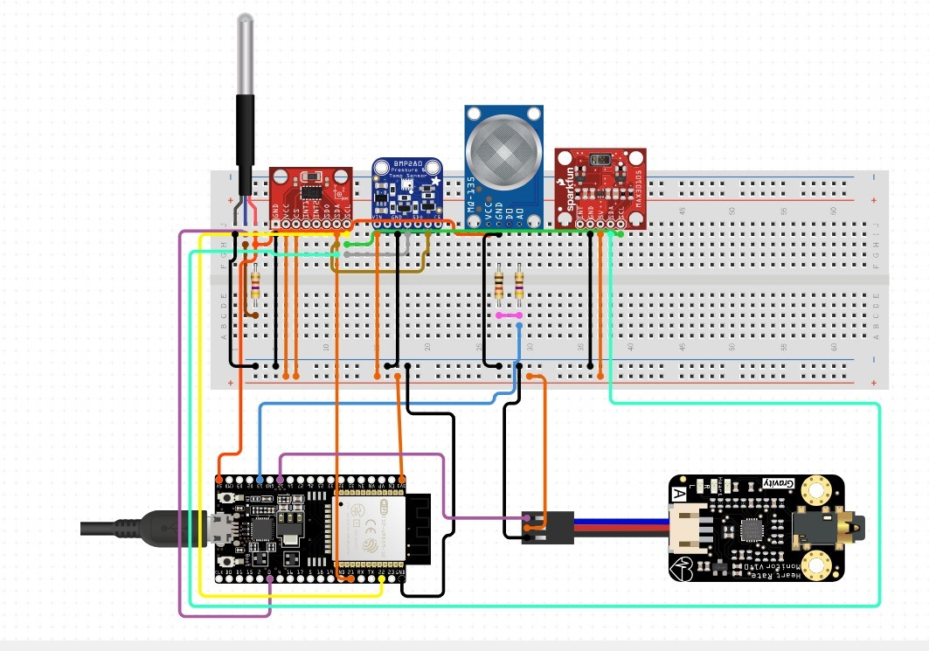
Screenshots & Wireframes

Slide 10
Screenshots & Wireframes

Slide 11
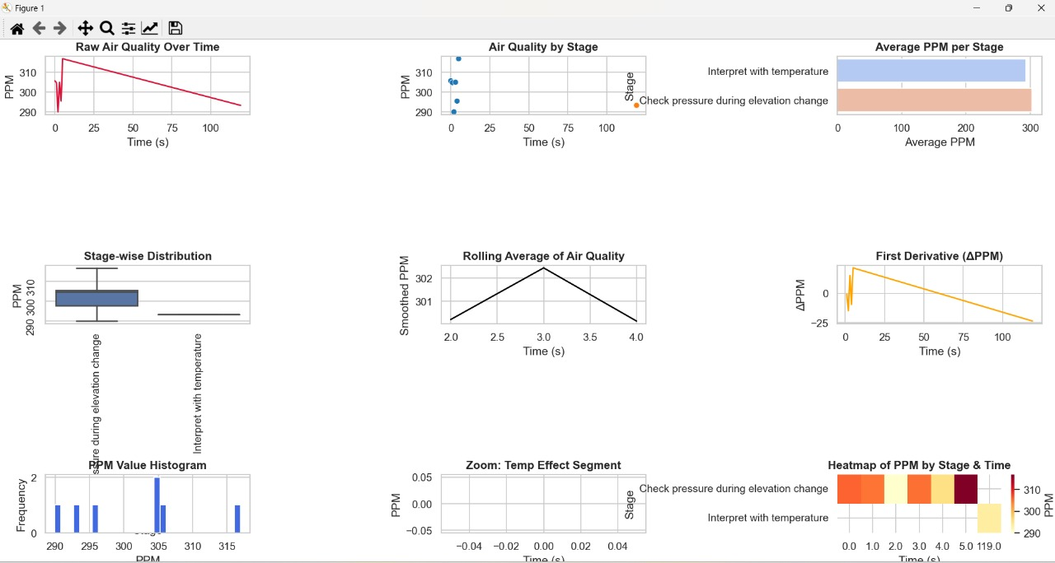
Screenshots & Wireframes

Slide 12
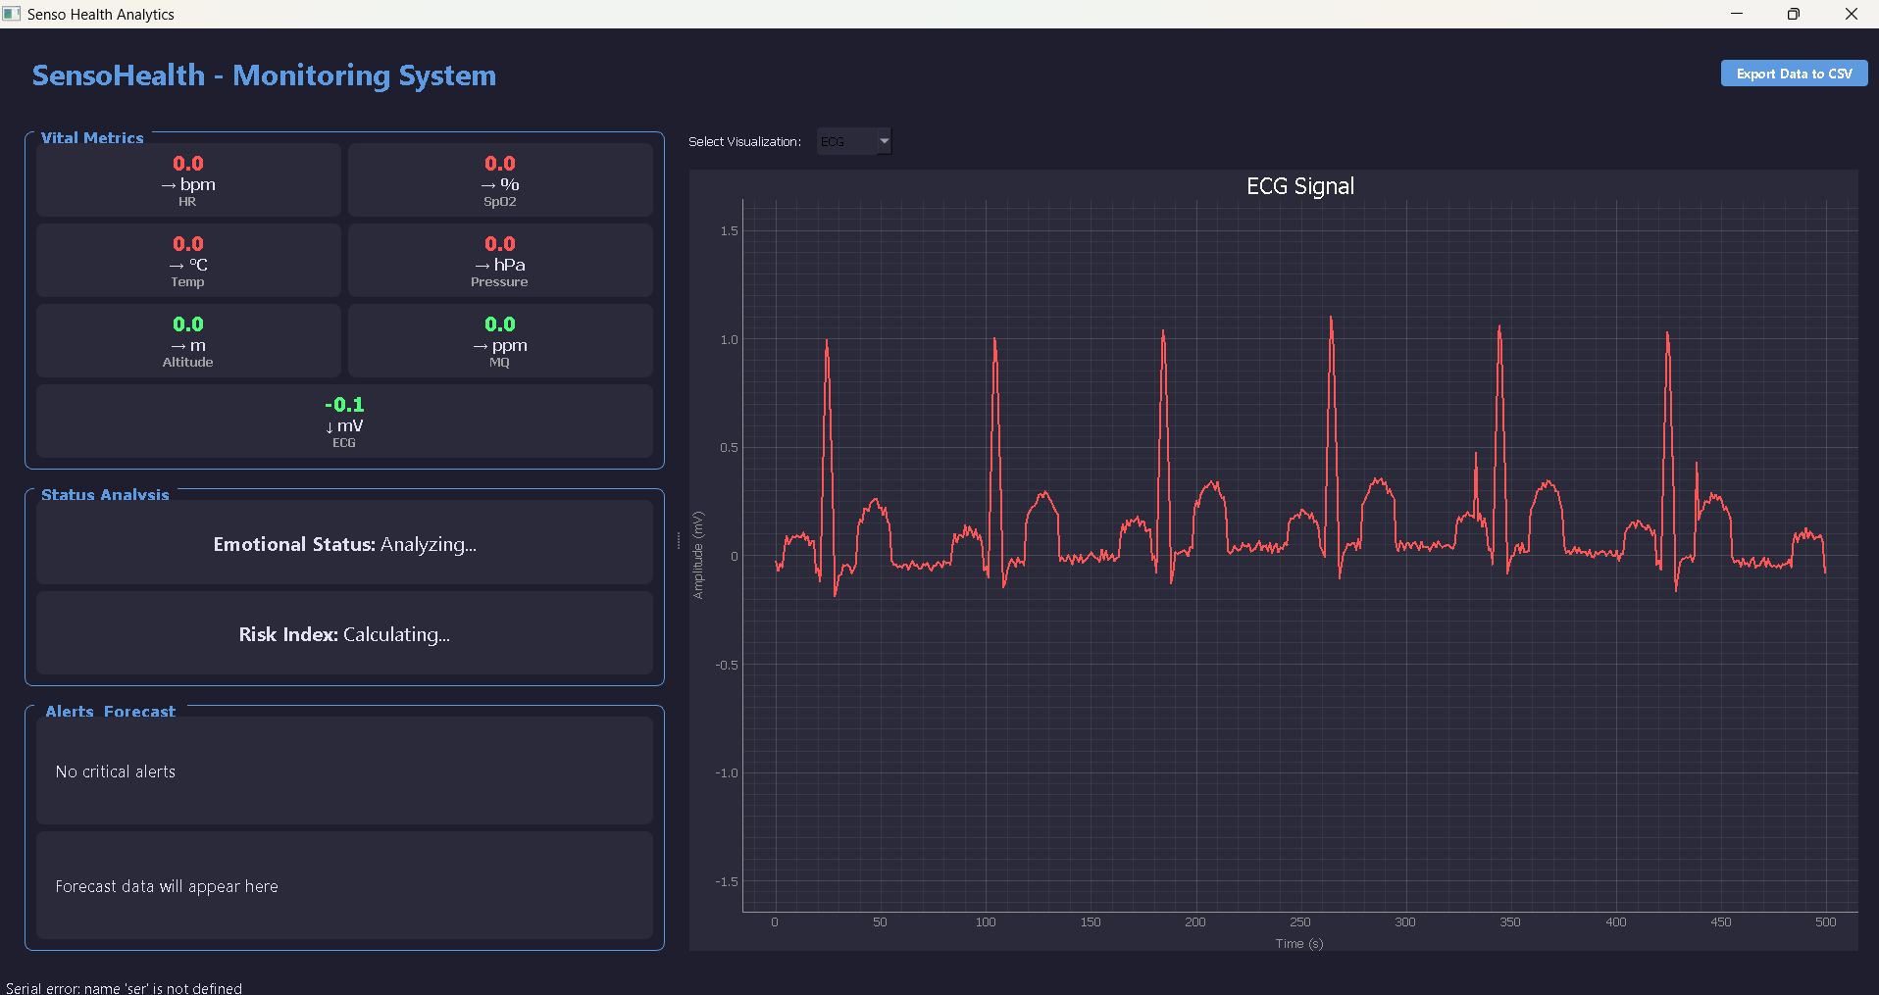
Screenshots & Wireframes

Slide 13
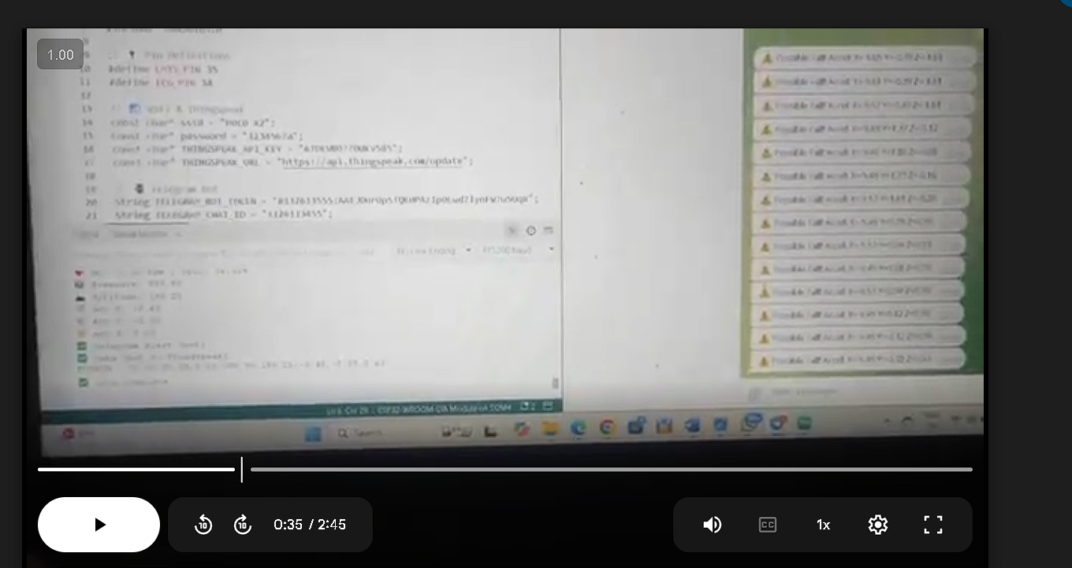
Screenshots & Wireframes
LINK: https://drive.google.com/file/d/16Ad1lGwIH42pDH1Y6s1ycDH8BzEPEF2q/view?usp=sharing

Slide 14
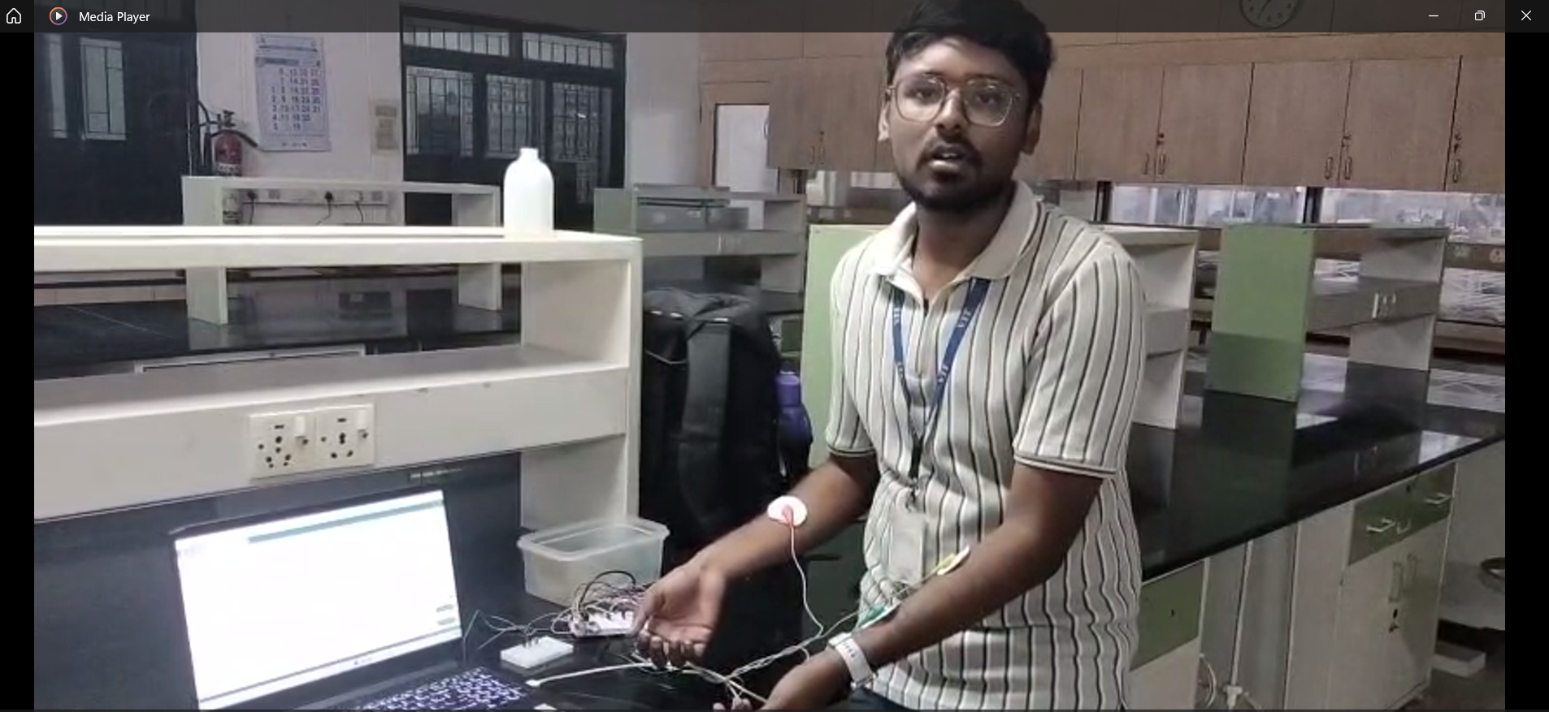
Screenshots & Wireframes
LINK: https://drive.google.com/file/d/1oahr23VaH1ktzGe77dklZe2Q2VhNCi7k/view?usp=drive_link

